Slide 1
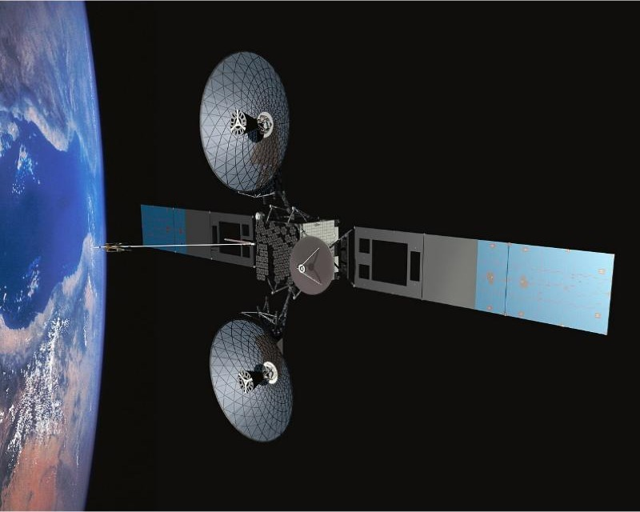
The internet
Y12 - Cambridge International 9618 | 2.2
Photo: NASA, Public domain, Wikimedia Commons
1
Notes:
Covers bit streaming (textbook 2.1.8) and all of textbook section 2.2: internet vs WWW; hardware that supports the internet (modems, PSTN, dedicated lines, cell phone network, satellites); IP addresses (IPv4, IPv6, subnetting, public/private, static/dynamic); URLs and DNS. It opens with a recall test and recap on network hardware (2.1.6). Scripting in HTML (2.2.6) is beyond the syllabus and is left out.
This is a lot of content: plan it as a double lesson, or split after slide 11 (bit streaming done) or slide 19.
Photos: Wikimedia Commons, full credits on the last slide.

Slide 2
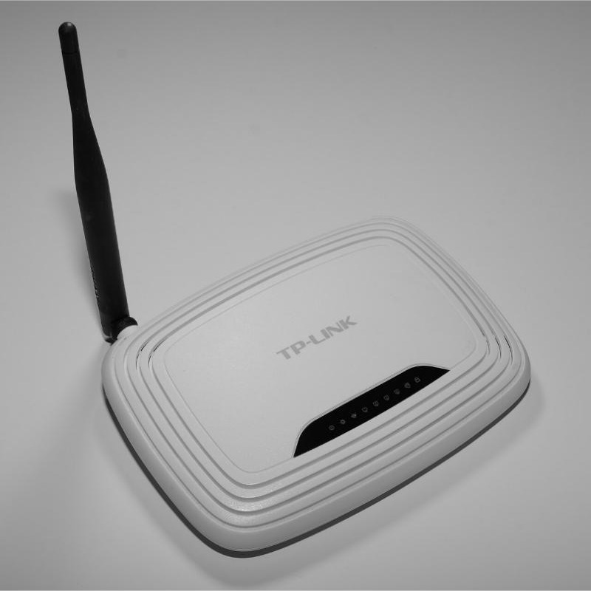
Recall test: network hardware
Starter activity
Worksheet Task 1 covers... | Marks
Q1 Match six devices to their purpose | 6
Q2 MAC address or IP address? | 3
Q3 Describe the role of a switch (9618/12 June 2025) | 3
Photo: Hayden Schiff, CC BY 4.0, Wikimedia Commons
1
Closed book - 8 minutes
No notes, no slides. Then swap and mark with a different colour pen.
2
Why?
Today you follow data out of the school LAN and across the internet - every device from last lesson appears on the way.
2
Notes:
Worksheet Task 1 - closed book, 8 minutes, then swap and mark from the answer key. It covers last lesson (2.1.6 network hardware). Q3 is a real question: 9618/12 May/June 2025 Q6(e). Re-teach threshold: fewer than 2/3 on Q3 or confusing MAC and IP addresses -> recap slides 3-4 before moving on.

Slide 3
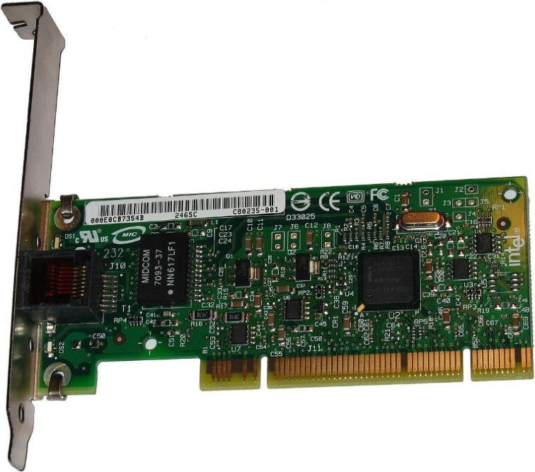
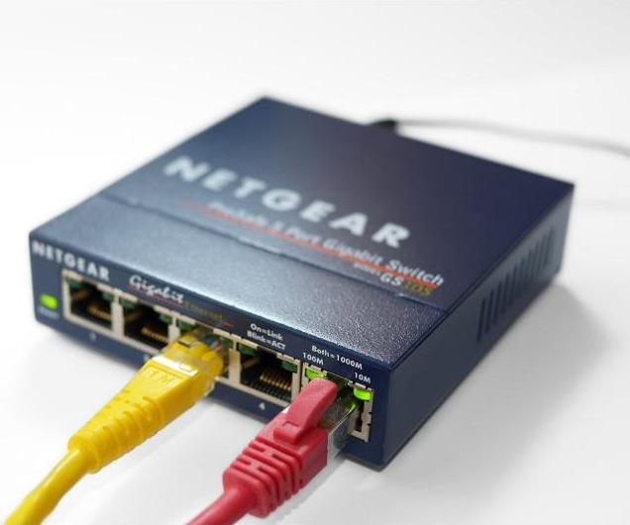
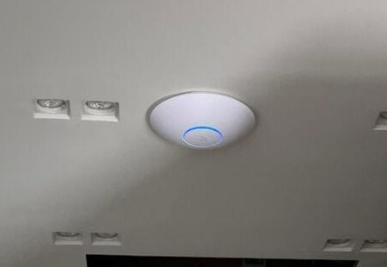
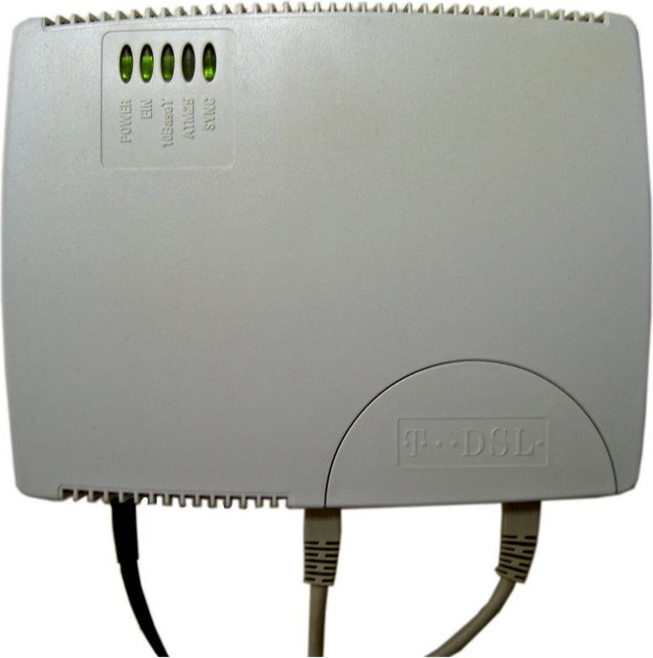
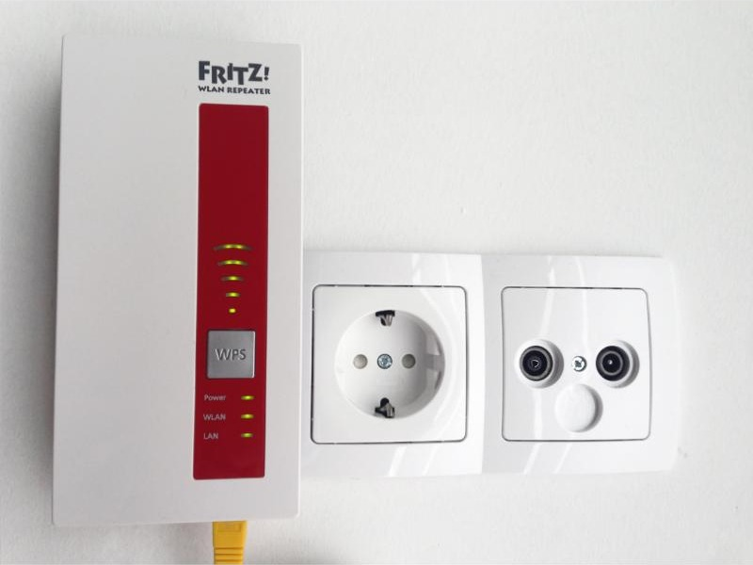
Recap: network hardware
Recap
NIC / WNIC
Switch
WAP
Connects a device to a (wireless) network; holds its MAC address
Forwards data only to the intended device, using MAC addresses
Connects wireless devices to the wired LAN using radio waves
Photo: Simon A. Eugster, CC BY-SA 3.0, Wikimedia Commons
Photo: Sabbo91, CC BY-SA 4.0, Wikimedia Commons
Photo: ktims, Public domain, Wikimedia Commons
Router
Repeater
Modem
Forwards packets between networks using IP addresses and a routing table
Restores a weakened signal so it can travel further
Converts digital data to analogue for a phone line, and back
Photo: Blingooo, CC BY-SA 4.0, Wikimedia Commons
Photo: Hayden Schiff, CC BY 4.0, Wikimedia Commons
Photo: Heidas, CC BY-SA 3.0, Wikimedia Commons
3
Notes:
Fast recap after marking Task 1. Cover the purpose line and ask students to say it first. Key exam wording from last lesson: a switch forwards data only to the intended device using MAC addresses; a router forwards packets between networks using the destination IP address and its routing table; a WAP connects wireless devices to the wired network using radio waves.

Slide 4
Recap: from your laptop to a website
Recap
School LAN
Outside the LAN
Internet
Laptop
(WNIC)
WAP
Switch
Router
Modem
ISP
Step | What happens
Laptop -> WAP | The WNIC turns data into radio waves; the WAP receives them
WAP -> switch -> router | The switch reads the MAC address and forwards the frame to the router
Router | Reads the destination IP; swaps the private IP for the public IP (NAT); forwards the packet
Modem -> ISP | Puts the data on the line (phone, fibre or cable) to the Internet Service Provider
4
Notes:
Bridge from last lesson to today. Walk left to right: the laptop's WNIC sends radio waves to the WAP; the switch forwards the frame to the router (the default gateway); the router uses NAT to swap the private IP for the school's public IP and forwards the packet; the modem or fibre terminal puts the data onto the line to the ISP. Everything right of the dashed line is "the internet" - today's topic.

Slide 5
In this lesson, you will
Objectives
Explain bit streaming, the role of the buffer, and why bit rate and broadband speed matter
Compare real-time and on-demand bit streaming
Describe the difference between the internet and the World Wide Web
Describe the hardware that supports the internet: modems, PSTN, dedicated lines, cell phone network
Explain IPv4 and IPv6 addresses, subnetting, public/private and static/dynamic addresses
Explain how a URL and the Domain Name Service (DNS) are used to find a web page
5

Slide 6
Bit streaming
Activity 1
Bit streaming: data (e.g. video or music) is sent as a continuous sequence of bits over a network, and played as it arrives rather than after the whole file has downloaded.
Media server
0110101100...
Buffer
Media player
Screen
temporary storage in RAM on your device
1
Compressed
2
Buffered
3
Played as it arrives
Files are compressed first, so fewer bits need to be sent
Bits arriving are stored in the buffer before they are played
No need to wait for - or store - the whole file
6
Notes:
Official definition (9618/11 May/June 2024 Q2(e)(i)): a continuous ordered flow of bits over a communication path. Textbook: a contiguous sequence of bits (digital data) sent over a network. The file is played as it arrives - it does not have to be downloaded first. Large files are compressed before transmission, and a buffer is used to give smooth playback.
Think-pair-share: what do you think the spinning "buffering" circle on YouTube actually means? (The buffer has run low: data is arriving more slowly than the player is using it.)

Slide 7
Why the buffer matters
Activity 1
1
Fill
high water mark
Bits arrive from the server faster than the player uses them, so the buffer fills before playback starts
2
Play
The player takes data from the buffer at a steady rate - smooth playback even if the network speed varies
3
Top up
Below the low water mark: the server is asked to send faster. Above the high mark: slower
low water mark
4
Empty = pause
If data arrives slower than it is played, the buffer empties and the video stops to "buffer"
Buffer
7
Notes:
Textbook 2.1.8: the rate data arrives from the server must be greater than the rate the media player takes it from the buffer. The player keeps the buffer between a low water mark and a high water mark; if it falls below the low mark the player asks the server to send faster, above the high mark slower. If the buffer empties, playback pauses ("buffering") until it refills.
Exam wording to use: the buffer stores data temporarily, so playback continues smoothly even if the data transfer rate varies / the connection drops briefly.

Slide 8
Real-time vs on-demand
Activity 2
 | Real-time (live) | On-demand
Source | A live event captured by camera / microphone | Files already recorded and stored on a server
How | Encoded as it happens and sent straight to the streaming server and viewers | Encoded in advance; a link on a web page streams the file when the user asks
Pause / rewind? | No - you see it as it happens | Yes - pause, rewind, fast-forward
When? | Only while the event is happening | Any time the user chooses
Examples | Live football, a live lesson, online radio | Netflix film, YouTube video, recorded lesson
Sort it: live football, Spotify playlist, a Teams lesson happening now, last week's recorded lesson, online radio.
8
Notes:
Textbook 2.1.8 plus mark-scheme wording (e.g. 9618/11 May/June 2024 Q2(e)): real-time is a live event, streamed as it happens - it cannot be paused, rewound or fast-forwarded and everyone sees the same point. On-demand files are already stored (encoded) on a server and can be watched at any time, paused, rewound and fast-forwarded.
Sort it: live football, Netflix film, a Spotify playlist, a live lesson on Teams, a recorded lesson, a radio station online.

Slide 9
Bit rate and broadband speed
Activity 2
Quality | Typical bit rate
Music | 0.3 Mbps
SD video | 3 Mbps
HD video (1080p) | 5 Mbps
4K video | 15-25 Mbps
The rule
Broadband speed must be at least the bit rate of the stream
Higher quality = higher bit rate = more bandwidth needed
If the connection is slower, the buffer empties and playback pauses
Typical values - they vary by service
1
Worked example
A 2-hour HD film streams at 5 Mbps. How much data is sent? 5 Mbps x 7200 s = 36 000 Mb = 4500 MB = 4.5 GB
Quick check: your broadband gives 3 Mbps. (a) What happens if you stream the HD film? (b) How could you watch it without pauses?
9
Notes:
Bit rate = the number of bits per second the media needs (higher quality = higher bit rate). Broadband speed = the number of bits per second the connection can deliver. If the broadband speed is lower than the bit rate, data is played faster than it arrives, the buffer empties and the stream pauses. Fixes: stream at a lower quality (lower bit rate), get faster broadband, or let a larger buffer fill first.
Worked answer: 5 Mbps x 7200 s = 36 000 Mb = 4500 MB = 4.5 GB for a 2-hour film. Quick check answers: (a) 3 Mbps < 5 Mbps, so the buffer empties and the film keeps pausing; (b) drop to SD at 3 Mbps or less.

Slide 10
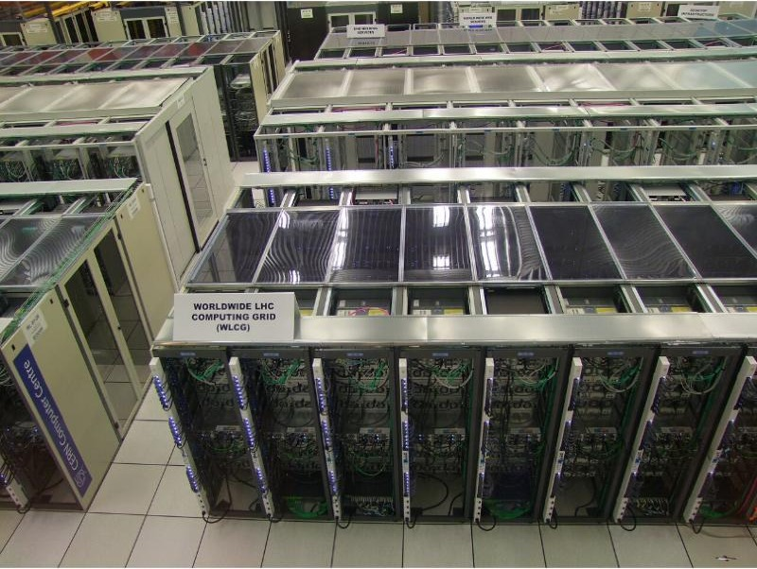
Bit streaming: pros and cons
Activity 2
Advantages
No need to wait for the whole file to download before watching
No need to store large files on your device
Files can be played on demand, whenever wanted
Harder to copy - some protection against piracy
Disadvantages
Cannot stream if the connection is lost
Pauses to "buffer" if the connection is slow or the buffer is too small
Uses a lot of bandwidth
Copyright and security issues with some sources
Streaming servers Photo: Marián Hubinský, CC BY-SA 4.0, Wikimedia Commons
10
Notes:
Textbook Table 2.7. Use this for "give advantages / disadvantages of streaming" questions - remember to apply each point to the scenario in the question.

Slide 11
The internet vs the World Wide Web
Activity 3
 | The internet | The World Wide Web (WWW)
What is it? | A global network of interconnected networks (the infrastructure) | A collection of linked web pages and resources
Made of... | Hardware: routers, cables, satellites, servers... | Information: web pages written in HTML
Protocols | TCP/IP | HTTP / HTTPS
Found using | IP addresses | URLs, through a web browser
Relationship | Carries the WWW - and email, VoIP, gaming... | Runs ON the internet - it is one service of many
The internet is the roads; the WWW is one kind of traffic using them. Email uses the internet but is not the WWW.
11
Notes:
Official points (e.g. 9618 Paper 1 questions on this - see the answer key): the internet is the hardware infrastructure - a global network of interconnected networks that uses TCP/IP; the WWW is a collection of (multimedia) web pages / resources, written in HTML, identified by URLs, accessed with a web browser using HTTP(S), that runs ON the internet. Email, VoIP, online gaming and file transfer use the internet but are not the WWW.
Analogy: the internet is the road network; the WWW is one kind of traffic (delivery vans) using it.

Slide 12
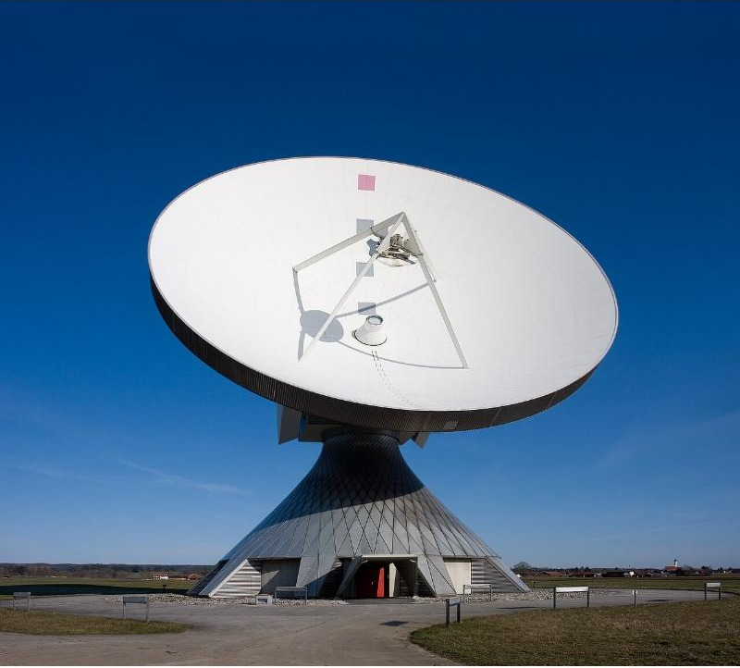
Hardware that supports the internet
Activity 4
Home router
+ modem
PSTN / broadband line
ISPs
Internet backbone
routers, fibre,
undersea cables
Photo: Richard Bartz, CC BY-SA 2.5, Wikimedia Commons
Company
LAN
dedicated (leased) line
Web
server
Mobile
phone
cell phone network
Satellites link continents and remote areas
Learn four: modem, PSTN, dedicated line, cell phone network.
12
Notes:
Syllabus: "Describe the hardware that is used to support the Internet - including modems, PSTN (Public Switched Telephone Network), dedicated lines, cell phone network." Overview first, then one slide each. The backbone between ISPs and countries is mostly fibre-optic cable (including undersea cables) plus satellites.

Slide 13
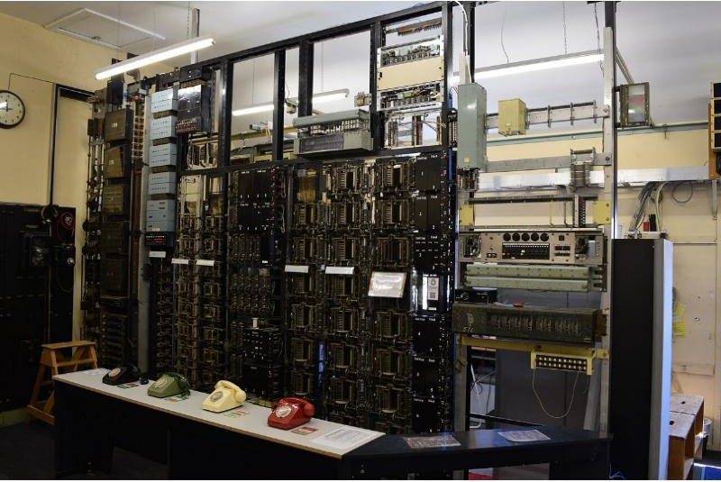
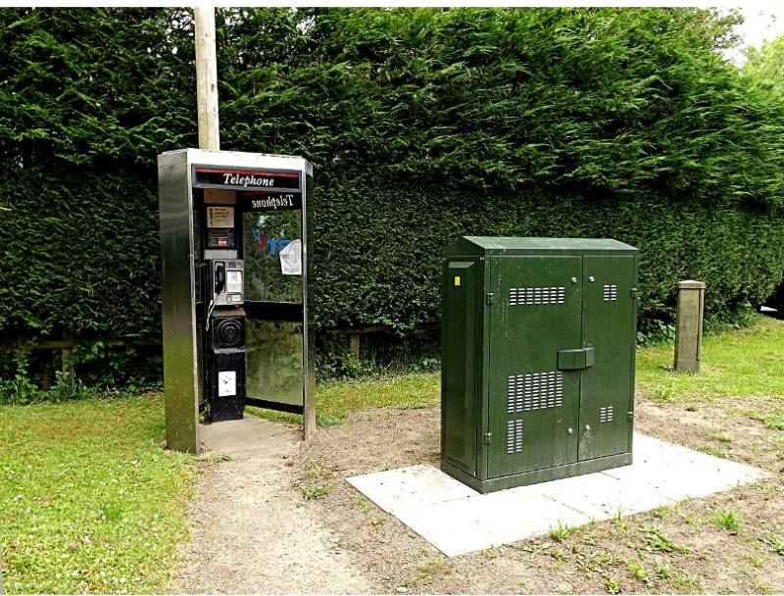
Modems and the PSTN
Activity 4
Modem (modulator-demodulator)
Converts digital data from the computer into analogue signals to send down a telephone line
Converts analogue signals received back into digital data
Telephone exchange Photo: David Palmer, CC BY-SA 4.0, Wikimedia Commons
PSTN (Public Switched Telephone Network)
The public telephone network of lines and exchanges, built for phone calls
Many types of line, so digital data may be converted to analogue
Data passes through switching centres to the ISP, both ways at once (duplex)
Street fibre cabinet Photo: Geographer, CC BY-SA 2.0, Wikimedia Commons
13
Notes:
Official modem point (9618/11 May/June 2025 Q2(c)): converts digital data into analogue for transmission down phone lines // converts analogue back into digital after transmission.
Official PSTN points (9618/12 May/June 2024 Q3(c)(ii), max 2): the PSTN consists of many different types of communication lines... so digital data may need to be converted to an analogue signal; data is transmitted in both directions at the same time (duplex); the communication passes through different switching centres / ISPs.
PSTN = Public Switched Telephone Network: the worldwide network of public telephone lines and exchanges, originally built for voice calls using circuit switching (a dedicated circuit for the whole call). Today much of it is digital and fibre, and home broadband uses it to reach the ISP. PSTN lines are shared by many users and are not dedicated to one organisation.
Photos: an old telephone exchange (switching equipment) and a street broadband fibre cabinet next to a phone box.

Slide 14
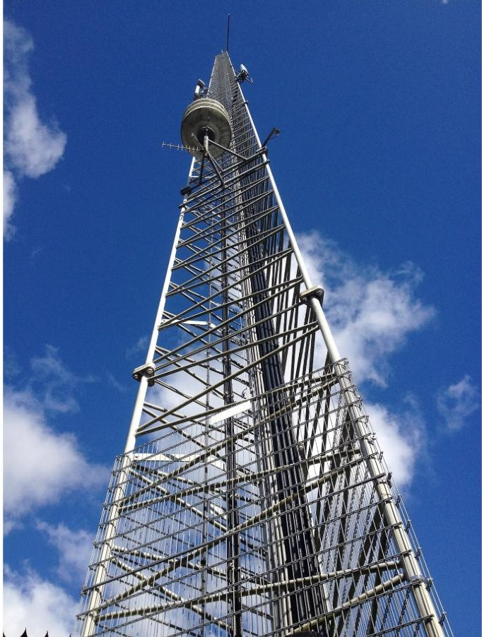
Dedicated lines, cell phones and satellites
Activity 4
Dedicated (leased) line
A direct, private connection between two sites, used only by one organisation: faster, always available and more secure - but expensive.
Cell phone network
Satellite Photo: NASA, Public domain, Wikimedia Commons
Land split into cells, each with a tower and antenna. Phones send and receive low-power radio signals to the tower; many phones share one tower.
Cell mast Photo: Hnapel, CC BY-SA 4.0, Wikimedia Commons
Satellites
Relay signals across oceans and to remote areas where cables cannot reach.
Ground station Photo: Richard Bartz, CC BY-SA 2.5, Wikimedia Commons
14
Notes:
Official points: dedicated line (9618/11 May/June 2025 Q2(c)) - provides a direct / private connection, so faster transmission. Cell phone network (9618/12 May/June 2025 Q6(b)): land is split into cells designed for maximum line of sight; each cell has a tower with an antenna that receives and transmits data; data is transmitted wirelessly between tower and phone using low-power radio signals; multiple devices can communicate with the same tower at once.
Dedicated (leased) line: a permanent, private connection between two sites, rented from a telecoms company and used only by that organisation - always on, guaranteed bandwidth, more secure, but expensive. Examiner report 9618/11 May/June 2025: "Dedicated lines are dedicated connections" earned nothing - say what it is used for.
Cell phone network: the area is divided into cells, each with a mast (base station); phones connect by radio waves to the nearest mast, which connects to the network; the mobile operator acts as the ISP (4G/5G).
Satellites (textbook): GEO ~35 800 km for long-distance communications; MEO for GPS; LEO for mobile/low-latency internet. Ground stations (dish photo) send and receive the signals.

Slide 15
Phone calls: PSTN vs VoIP
Activity 4
 | PSTN (traditional phone) | VoIP (internet call)
Switching | Circuit switching - one circuit kept open for the whole call | Packet switching - voice split into packets that take any route
When is data sent? | All the time, even in silences | Only while someone is talking
Data | Voice signal | Voice digitised and compressed into packets
Power cut? | Usually still works (line has its own power) | Needs the router / internet to be working
Cost | Charged per call / distance | Usually free over an internet connection
15
Notes:
Textbook comparison. PSTN calls use circuit switching: a dedicated circuit is set up and kept open for the whole call, even during silences. Internet calls (VoIP - Voice over Internet Protocol) digitise and compress the voice, split it into packets and send them by packet switching; the connection only carries data while someone is talking, so a 10-minute call may only send ~3 minutes of data. Packet switching vs circuit switching is covered fully in Chapter 14 (A Level).

Slide 16
IP addresses: IPv4 and IPv6
Activity 5
IPv4 - 32 bits
IPv6 - 128 bits
4 groups of 8 bits, written in denary (0 to 255)
Separated by full stops
2^32 = about 4.3 billion addresses
8 groups of 16 bits, each 4 hex digits
Separated by colons
2^128 addresses - enough for every device
192.168.10.77
2001:0DB8:0000:0000:0000:FF00:0042:8329
11000000.10101000.00001010.01001101
2001:DB8::FF00:42:8329
the same IPv6 address after zero compression
Why IPv6? IPv4 is running out of addresses. IPv6 also removes the need for NAT and private-address clashes.
1
Drop leading zeros
2
Replace zero groups
3
Only once
0DB8 -> DB8, 0042 -> 42
One run of 0000 groups -> ::
Two lots of :: would be ambiguous
16
Notes:
An IP address identifies a device on a network so packets can be routed to it. IPv4: 32 bits, written as four denary numbers 0-255 separated by full stops (each is one byte). About 4.3 billion addresses - not enough, so IPv6 was introduced. IPv6: 128 bits, written as eight groups of four hexadecimal digits (16 bits each) separated by colons. Leading zeros in a group can be dropped, and ONE run of all-zero groups can be replaced by :: (zero compression) - only once, or the address is ambiguous.
Benefits of IPv6 (textbook): far more addresses, no need for NAT, no private-address collisions, built-in authentication, more efficient routing.

Slide 17
Valid or invalid?
Activity 5
1 10.24.156.3
Check
2 192.168.1.256
IPv4: 4 groups, each 0-255
IPv6: 8 groups of hex (0-9, A-F)
:: only once
3 172.16.4.20.1
4 FE80:0000:0000:0000:0202:B3FF:FE1E:8329
5 FE80::202:B3FF:FE1E:8329
6 2001::85A3::7334
7 2001:0DB8:85G3:0000:0000:8A2E:0370:7334
8 1:2:3:4:5:6:7:8:9
Valid IPv4, valid IPv6 or invalid? Give a reason for each invalid one.
17
Notes:
Answers: 1 valid IPv4. 2 invalid - 256 is more than 255. 3 invalid - IPv4 has 4 groups, this has 5. 4 valid IPv6 (8 groups of 4 hex digits). 5 valid IPv6 using zero compression once. 6 invalid - :: used twice, ambiguous. 7 invalid - G is not a hexadecimal digit. 8 invalid - 9 groups in IPv6.
Worksheet Task 3 has a real exam version of this.

Slide 18
Network ID, host ID and subnetting
Activity 5
 | Network ID (24 bits) | Subnet | Host
192.168.10.77/26 | 192.168.10 | 01 | 001101
Mask 255.255.255.192 | 11111111.11111111.11111111 | 11 | 000000
IP AND mask | 192.168.10 | 01 | 000000 = .64
Subnetting
Why do it?
Splits one network into smaller sub-networks
Some host bits become a subnet ID
AND the IP with the subnet mask to find which subnet a device is in
Less traffic in each subnet - faster
More secure: e.g. students and finance kept apart
Easier to manage and to find faults
18
Notes:
An IP address has two parts: the network ID (which network) and the host ID (which device on it). Routers on the internet route by the network ID first; the destination network then delivers to the host. A CIDR suffix such as /24 says how many bits are the network ID.
Subnetting divides one network into smaller sub-networks by borrowing host bits as a subnet ID. Benefits: less broadcast traffic in each subnet, better security (departments separated), easier management, more efficient use of addresses.
Worked example: 77 = 01001101, mask 192 = 11000000; AND gives 01000000 = 64, so 192.168.10.77 is in the subnet 192.168.10.64 (hosts .65 to .126). Note: the textbook's university example (192.200.20...) has typos (e.g. "192.200.20.03"); use this example instead.

Slide 19
Public vs private, static vs dynamic
Activity 5
 | Private IP | Public IP
Given by | The router (inside the LAN) | The ISP
Unique? | Only within its own LAN | Across the whole internet
Reachable from the internet? | No - hidden behind the router (NAT) | Yes
Ranges | 10.x.x.x 172.16-31.x.x 192.168.x.x | All other valid addresses
 | Static IP | Dynamic IP
Changes? | Never - fixed | Can change each time the device connects
Allocated by | Set manually / permanently by the ISP | Automatically (DHCP) from a pool
Used for | Servers that must always be found (web, email, DNS) | Most home devices and phones
Cost | Costs more | Cheaper - addresses are reused
19
Notes:
Private IP: assigned by the router to devices inside a LAN; only unique within that LAN; cannot be reached directly from the internet; reserved ranges (10.x.x.x, 172.16-31.x.x, 192.168.x.x). Public IP: assigned by the ISP; unique on the internet; visible to the internet. The router has one of each (9618/13 Oct/Nov 2024 Q9(d)(i): public so the router is visible to the internet / WAN; private so it is identified by computers within the LAN). NAT lets all devices share the router's public IP.
Static: does not change; set manually or permanently allocated by the ISP; used for servers (web, email, DNS) so they can always be found. Dynamic: allocated (by DHCP) each time a device connects and can change; cheaper; ISP reuses addresses.

Slide 20
Uniform Resource Locator (URL)
Activity 6
https://
www.cambridgeinternational.org
/programmes/
index.html
Protocol
Domain name
Path
File name
Rules for transferring the page (HTTP or HTTPS - secure)
Host (www) + organisation name + domain type (.org)
Folders on the web server
The resource (page) wanted
How a URL is used
The user types the URL (or clicks a link) in a web browser
The browser asks a DNS server for the IP address of the domain name
The browser then requests the page from the web server at that IP address, using HTTP(S)
20
Notes:
A URL is the text address of a resource on the WWW. Format: protocol://domain name/path/file name. The domain name is made of the host (www), the organisation name and the domain type (.com, .org, .gov, .ac) and sometimes a country code (.uk, .th).
Textbook slip: it says URLs "are represented by a set of four numbers, such as 109.108.158.1" - that is an IP address, not a URL. A URL is turned INTO an IP address by DNS (next slide).

Slide 21
Domain Name Service (DNS)
Activity 6
Web server
5
1 Browser sends the domain name to DNS server 1
Computer
(browser)
2 Not in its database / cache, so it asks DNS server 2
4
3 DNS server 2 finds the IP address and sends it back; server 1 caches it
1
2
4 The IP address is returned to the browser
DNS server 1
DNS server 2
5 The browser requests the page from the web server at that IP; the server sends it back
3
21
Notes:
DNS (domain name service / system) is a system of servers that store databases of domain names and their matching IP addresses, so users can type easy-to-remember names. Textbook Figure 2.25. If DNS server 1 does not have the name in its database or cache it asks another DNS server; the answer is cached for next time.
Exam answers should mention: the URL / domain name is sent to a DNS server; the DNS server looks up (searches) its database for the matching IP address; if not found it is passed to another (higher-level) DNS server; the IP address is returned to the browser; the browser sends the request to that IP address; the web server returns the page.

Slide 22
Exam focus: bit streaming
Exam focus
9618/13 Oct/Nov 2024 Q9(c) Explain how bit streaming is used in a real-time video conference. [4]
Official marking points (max 4)
Data is compressed before transmitting | ... transmitted continuously as a series of bits
... uploaded to a media server | The media server sends the data to a buffer
The buffer stores data until the device can process it | The receiving device receives the bit stream from the buffer
9618/11 May/June 2024 Q2(e)(ii) Give two differences between real-time and on-demand bit streaming. [2]
Official marking points (1 each)
Real-time is direct from the source, whereas on-demand is pre-recorded / downloaded to view later
Real-time cannot be re-watched, whereas on-demand can be paused, re-watched etc.
Real-time plays continually; on-demand downloads sections and cannot play until the next section has downloaded
22
Notes:
Show AFTER students attempt worksheet Task 2. Official marking points for 9618/13 Oct/Nov 2024 Q9(c) [4] and 9618/11 May/June 2024 Q2(e)(ii) [2]. The same answer structure scored in 9618/11 May/June 2025 Q2(a) [4]. Examiner reports: describe WHY a buffer is needed, not just how it works (Nov 2022); for compression questions say why lossy is chosen (less data, less bandwidth, less buffering), not how it works (Nov 2023).

Slide 23
Exam focus: IP addresses
Exam focus
9618/12 Oct/Nov 2023 Q7(d) Complete the table by writing the missing types of IP addresses and the missing descriptions. [4]
Type | Description
Public | Assigned to a device to allow direct access on the internet
Private | Used for internal LAN communication only
Static | Fixed - does not change each time the device re-joins the network
Dynamic | May change each time the device re-joins the network
1
8 groups, not 6
2
Double colon
3
Not "random"
4
ID, not IP
IPv6 = eight groups of four hex digits
:: replaces groups of zeros - once only
A dynamic IP changes when the device reconnects
Say network ID and host ID
23
Notes:
Show AFTER worksheet Task 4. Official answers: 9618/12 Oct/Nov 2023 Q7(d) [4] and 9618/11 May/June 2023 Q4(d)(i) [5] (4; 8; 8; 16; double colon). Examiner reports: "there are eight groups of digits in IPv6 not six" (Nov 2023); a single colon instead of a double colon was a common wrong answer (June 2023); "an IP address that randomly changes" is not enough for dynamic (Nov 2023); and say network ID / host ID, not "network IP / host IP" (June 2023).

Slide 24
Guided practice
Activity 8
Task | What you do | Marks
1 Recall test | Network hardware - closed book | 12
2 Bit streaming | Real 9618 questions; bit rate and broadband speed | 12
3 The internet and its hardware | Internet vs WWW; modems, dedicated lines, PSTN, cell network | 9
4 IP addresses | IPv4 / IPv6 format, valid or invalid, public / private, static / dynamic | 15
5 Subnetting, URLs and DNS | Network ID and host ID; benefits of subnetting; URL parts; the DNS process | 13
6 Extension | Compressing a live stream; using a subnet mask | 10
Check your work against the answer key when your teacher shares it.
24
Notes:
Most students should finish Tasks 1-5 in a double lesson; Task 6 is extension or homework. Real past-paper questions are cited under each part.

Slide 25
Common misconceptions
Plenary
Misconception | Why it is wrong
The internet and the WWW are the same thing | The internet is the network infrastructure; the WWW is web pages that run on it
Streaming means downloading the file first | The bits are played as they arrive; the whole file is never stored
A buffer makes the connection faster | It only stores data temporarily so playback stays smooth when the rate varies
IPv6 has six groups separated by single colons | Eight groups of four hex digits; :: replaces zero groups once only
A dynamic IP address changes randomly | It may change each time the device reconnects to the network
A URL is a set of four numbers | That is an IP address - DNS turns the domain name in the URL into an IP address
"Network IP" and "host IP" | The two parts are the network ID and the host ID
"Dedicated lines are dedicated connections" | Say what it is: a direct, private link used only by one organisation - faster and more secure
25
Notes:
Sources: Principal Examiner reports for 9618 Paper 1 and the textbook. Ask students which ones they believed at the start of the lesson.

Slide 26
Exit question
Plenary
On a sticky note or mini-whiteboard:
a
Streaming
State one difference between real-time and on-demand bit streaming. [2]
b
DNS
A user types www.bbc.co.uk into a browser. Explain the role of the DNS. [2]
c
IPv6
Write down a valid IPv6 address that uses zero compression. [1]
26
Notes:
Model answers:
(a) Real-time: a live event streamed as it happens - cannot be paused / rewound (1). On-demand: stored files streamed when the user requests them - can be paused / rewound (1).
(b) The browser sends the domain name to a DNS server (1); the DNS server looks up / finds the matching IP address and returns it to the browser (1).
(c) Any valid IPv6 with :: used once, e.g. 2001:DB8::1 (1).

Slide 27
In this lesson, you
Summary
Explained bit streaming, buffering, bit rate and broadband speed; compared real-time and on-demand
Separated the internet (the network) from the WWW (the web pages that run on it)
Described modems, the PSTN, dedicated lines, the cell phone network and satellites
Read and checked IPv4 and IPv6 addresses; used a subnet mask; compared public/private and static/dynamic
Followed a URL through the DNS to a web server
Next lesson: past-paper practice on 2.1 and 2.2 (edit to match your scheme)
27
Notes:
Next lesson: edit to match your scheme - e.g. 3.1 Computers and their components, or a past-paper practice lesson on all of 2.1/2.2.

Slide 28
Photo credits
Credits
Photo | Author | Licence
Netgear Gigabit Switch 5-port | Simon A. Eugster | CC BY-SA 3.0
TP-Link TL-WR740N router | Hayden Schiff | CC BY 4.0
Access Point UniFi | Sabbo91 | CC BY-SA 4.0
Intel PRO-1000 GT PCI NIC | ktims | Public domain
Rack of Worldwide LHC Computing Grid | Marián Hubinský | CC BY-SA 4.0
Fritz WLAN repeater an der Steckdose | Blingooo | CC BY-SA 4.0
T-DSL Modem | Heidas | CC BY-SA 3.0
TDRS gen3 (artist's impression) | NASA | Public domain
Cell Phone Tower Monnickendam | Hnapel | CC BY-SA 4.0
Telephone Box and Broadband Fibre Cabinet (geograph 4030096) | Geographer | CC BY-SA 2.0
Erdfunkstelle Raisting 2 | Richard Bartz | CC BY-SA 2.5
Ferrymead Heritage Park telephone switch equipment 04 | David Palmer | CC BY-SA 4.0
All photos from Wikimedia Commons (commons.wikimedia.org), used under the licences shown. Cropped for layout.
28

